Slide 1

Urban Acoustics
Week 2 Tutorial
Conceptual questions
Calculation of L_{eq},L_{Aeq},L_{day},L_{evening},L_{night},L_{den} dr.ir. Maarten Hornikx dr. Matthias Cosnefroy

Slide 2
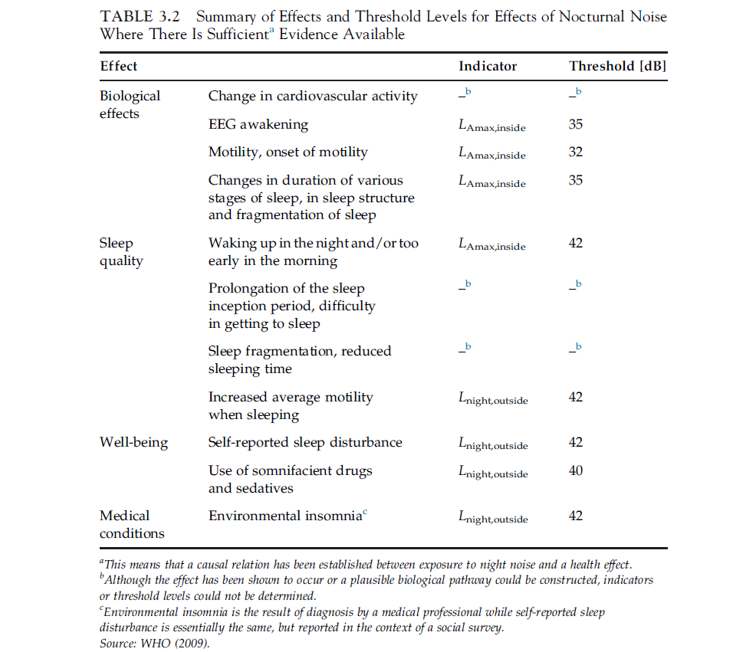
Conceptual questions
Question 1 :
Environmental noise may cause various health effects. Explain whether equivalent noise levels below 50 dB(A) can affect health.
Answer
Yes. Refer page 58, Environmental noise pollution. Refer page 58 and 64, Burden of disease from environmental noise.
7S0X0 / 7W8X0
2017/02/09
PAGE 2
PAGE <number>

Slide 3
Conceptual questions
Question 2 :
Explain why noise maps according to the European Noise Directive are currently produced by calculations rather than by using measurement results.
Answer
To get detailed measured noise maps, the measurements would be prohibitively expensive and time-consuming. Refer chapter 2.5.6, ‘Environmental noise pollution.’ That’s why measurements are only used locally to validate the calculation results.
7S0X0 / 7W8X0
2017/02/09
PAGE 3
PAGE <number>

Slide 4
Conceptual questions
Question 3 :
For what adverse health effects is the L_{den} indicator a good metric?
Answer:
Overall annoyance. Refer page 31 of ‘Environmental noise pollution’.
7S0X0 / 7W8X0
2017/02/09
PAGE 4
PAGE <number>

Slide 5
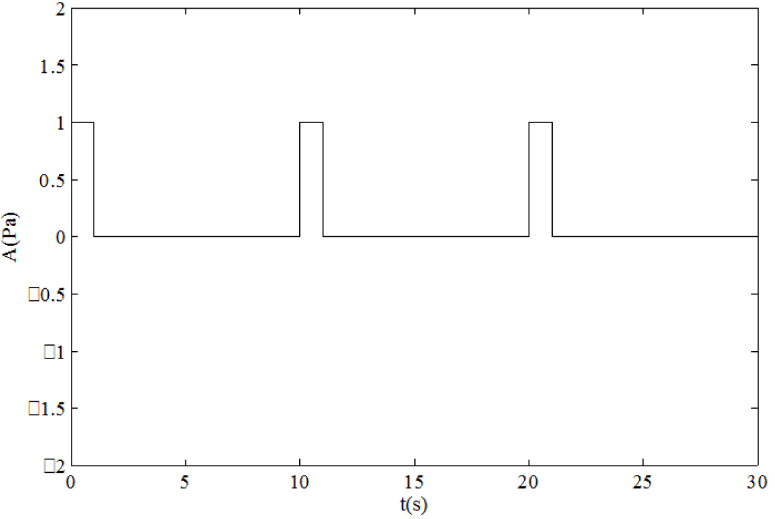
Exercises
Exercise 1:
An emergency signal has a periodicity of 10 s and can be described as
with
with the time t, the angular frequency ω=2πf, f=1000 Hz, the amplitude of the signal A. In the figure below, the amplitude is shown as a function of time.
-
-
-
-
7S0X0 / 7W8X0
2017/02/09
PAGE 5
PAGE <number>

Slide 6
Exercises
Exercise 1:
a) What is the equivalent sound pressure level L _{eq,T} of this signal when averaging over the first 5 s of this signal, i.e. T = 5 s?
Answer :
Integration period T = 5 s
Reference pressure p_{ref} = Pa
7S0X0 / 7W8X0
2017/02/09
PAGE 6
PAGE <number>

Slide 7
Exercises
Exercise 1:
a) What is the equivalent sound pressure level L _{eq,T} of this signal when averaging over the first 5 s of this signal, i.e. T = 5 s?
Answer :
Now, decompose the integral:
And replace:
7S0X0 / 7W8X0
2017/02/09
PAGE 6
PAGE <number>

Slide 8
Exercises
b) What is 𝐿_{eq,T} with T = 100 s? Why is this value lower or higher than the result of a)?
Since the period of the emergency signal is 10 s, we can rewrite the integral as
Now, replace:
7S0X0 / 7W8X0
PAGE 8

Slide 9
Exercises
b) What is 𝐿_{eq,T} with T = 100 s? Why is this value lower or higher than the result of a)?
so
Here, the two values are different because L_{eq,100} is computed over whole periods (100 s is a multiple of the signal period of 10 s), while L_{eq,5} is computed over a truncated period (5 is not a multiple of 10). In other words, here only the remainder of the ratio between T and the signal period matters (a.k.a., the modulo operator: 5 modulo 10 = 5, while 100 modulo 10 = 0).
You can check that L_{eq,10} = L_{eq,100} , since 10 modulo 10 = 100 modulo 10 = 0.
This is a special property of periodic signals. We also have L_{eq,10} < L_{eq,5} , because within a period the integration if performed over a longer time for L_{eq,10}, which decreases the average since the signal is 0 between 5 and 10 seconds.
Bottom line: for impulsive/short noise (shorter than T), longer integration time = lower L_{eq} ,
but not necessarily true for longer signals (e.g., continuous noise)
7S0X0 / 7W8X0
PAGE 8

Slide 10
Exercises
Exercise 2:
Two friends have their student flat along different roads of the city. Both are annoyed by road traffic noise at home. They are curious who of them suffers from the highest noise level. They decide to measure the equivalent sound pressure level in the open window of each of their flat, in L^{eq,j} (dB), with j the octave band index. The results are listed in Table below. We can consider the level to be the level incident to the facade of their flat. For comparing their results, they decided to compare the single number equivalent level by energetically adding the levels of all octave bands.
7S0X0 / 7W8X0
2017/02/09
PAGE <number>1
PAGE <number>

Slide 11
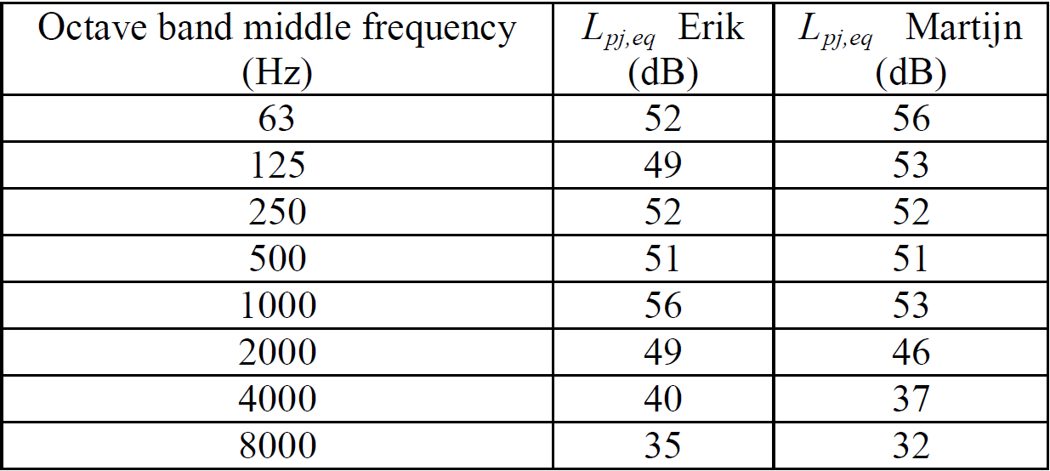
Exercises
Exercise 2:
a) Compute the level L_{eq} (dB) at the facades of the student apartments of Erik and Martijn.
7S0X0 / 7W8X0
2017/02/09
PAGE <number>2
PAGE <number>

Slide 12
Exercises
Answer 2a):
7S0X0 / 7W8X0
2017/02/09
PAGE <number>3
PAGE <number>

Slide 13
Exercises
Answer 2a):(continuation)
7S0X0 / 7W8X0
2017/02/09
PAGE <number>4
PAGE <number>

Slide 14
Exercises
Exercise 2:
b) Who has the highest level when computing L_{Aeq} (dB(A)), i.e. taking into account A-weighting in the calculations?
7S0X0 / 7W8X0
2017/02/09
PAGE <number>5
PAGE <number>

Slide 15
Exercises
Frequency (Hz) | A-Weighting Correction (dB)
31.5 | -39.4
63 | -26.2
125 | -16.1
250 | -8.6
500 | -3.2
1kHz | 0
2kHz | 1.2
4kHz | 1
8kHz | -1.1
16kHz | -6.6
Answer 2b):
Add A-Weighted correction to L_{pj,eq}
7S0X0 / 7W8X0
PAGE <number>

Slide 16
Exercises
Answer 2b): (continuation)
Erik has the highest level
c) Finally, Erik notices that his measurement took 30 minutes while Martijn only has measured for a period of 10 minutes. What correction should we apply to the measured levels to compared them in a fair way?
Answer 2c) : There is no way to correct this. If they still have the recordings, they could both take the first 10 minutes to compute the noise level. But we can assume that the comparison is still quite fair if the road traffic noise is continuous.
7S0X0 / 7W8X0
2017/02/09
PAGE <number>7
PAGE <number>

Slide 17
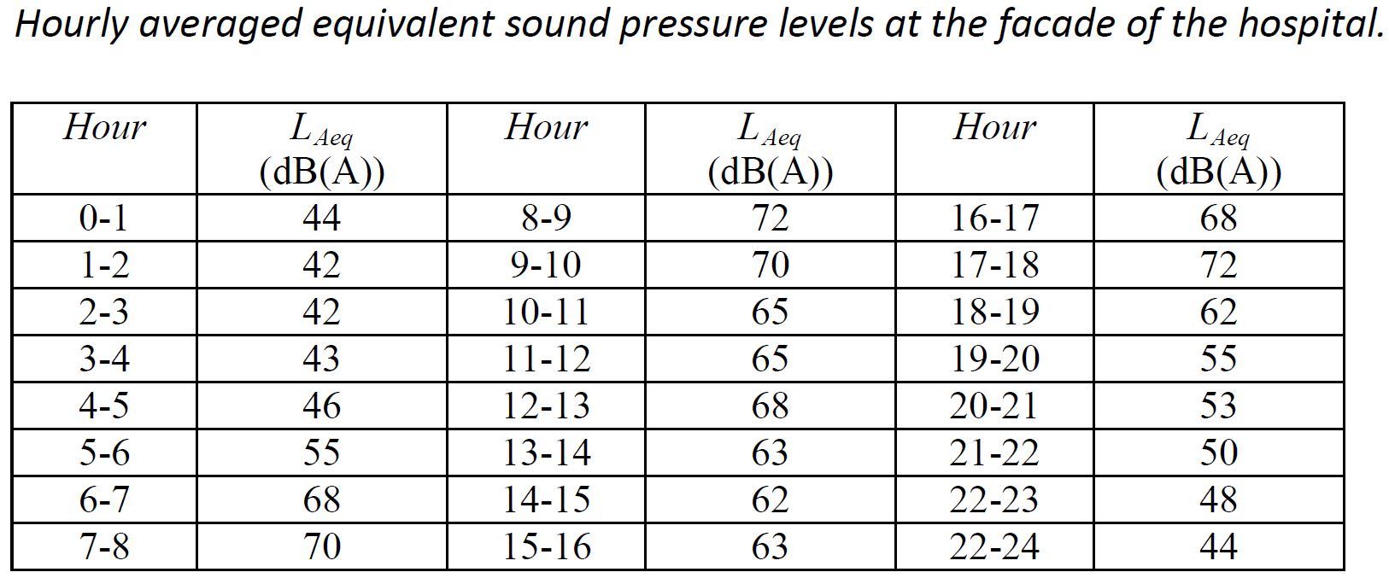
Exercises
Exercise 3:
The yearly averaged sound pressure levels due to noise from road traffic L_{day}, L_{evening} and L_{night}, should be computed at the facade of a hospital. Table 2 shows the hourly averaged values.
7S0X0 / 7W8X0
2017/02/09
PAGE <number>8
PAGE <number>

Slide 18
Exercises
Exercise 3:
Day : 07:00-19:00
Evening : 19:00-23:00
Night : 23:00-07:00
a) Compute L_{day}, L_{evening} and L_{night} from Table .
Logarithmic mean of the hourly levels:
7S0X0 / 7W8X0
2017/02/09
PAGE <number>9
PAGE <number>

Slide 19
Exercises
Exercise 3:
a) Compute L_{day}, L_{evening} and L_{night} from Table .
b) Compute L_{den}
7S0X0 / 7W8X0
2017/02/09
PAGE 20
PAGE <number>

Slide 20
The end.
Questions?
Some more questions: m.h.r.cosnefroy@tue.nl
7S0X0 / 7W8X0
2017/02/09
PAGE 23
PAGE <number>

